Slide 1

Florida Specialty
License Plate Association, Inc.
“There’s a New Sheriff in Town…”

Slide 2

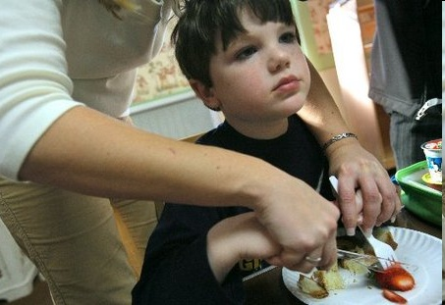
$80,000 for Autism Intervention Programs

Slide 3
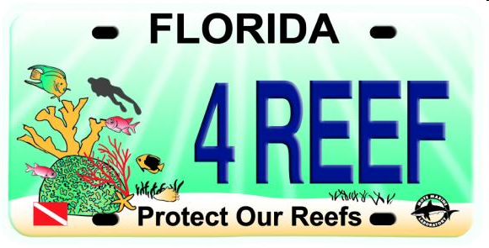
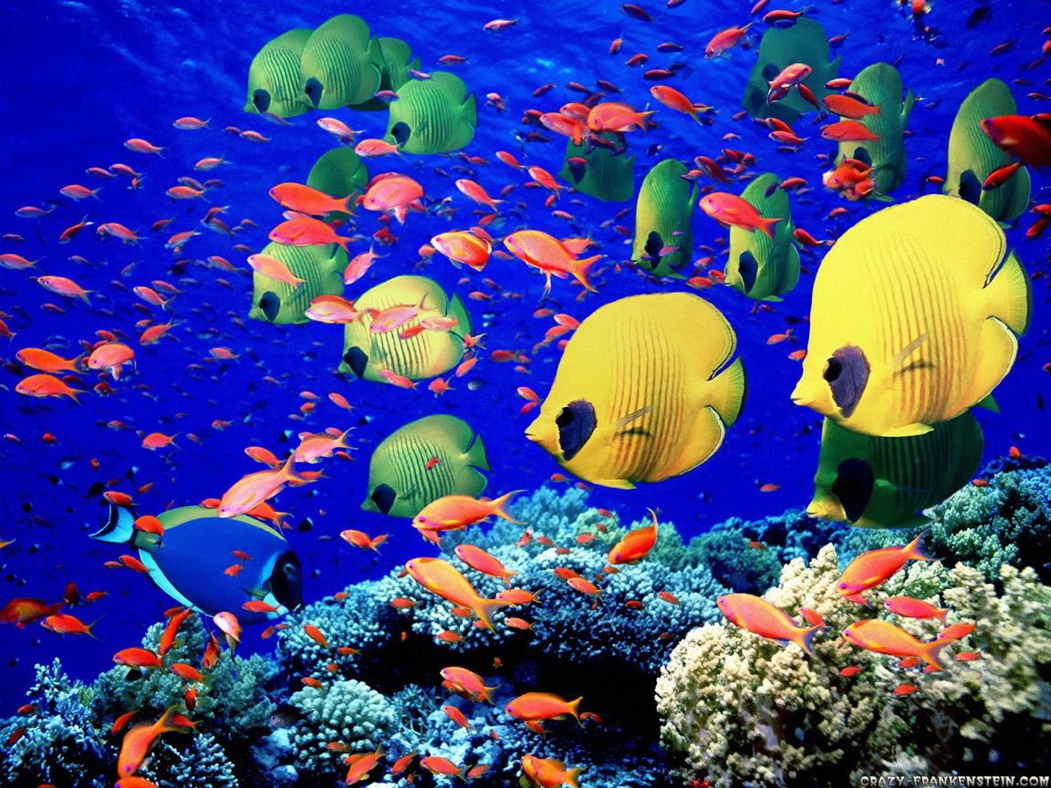
$6 Million for Sea Life
The Protect Our Reefs Grant Program
An Enormous Economic Driver
for Florida

Slide 4


$675,000 for Education

Slide 5
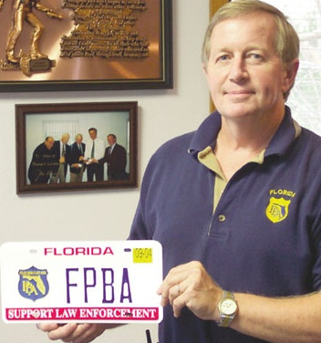
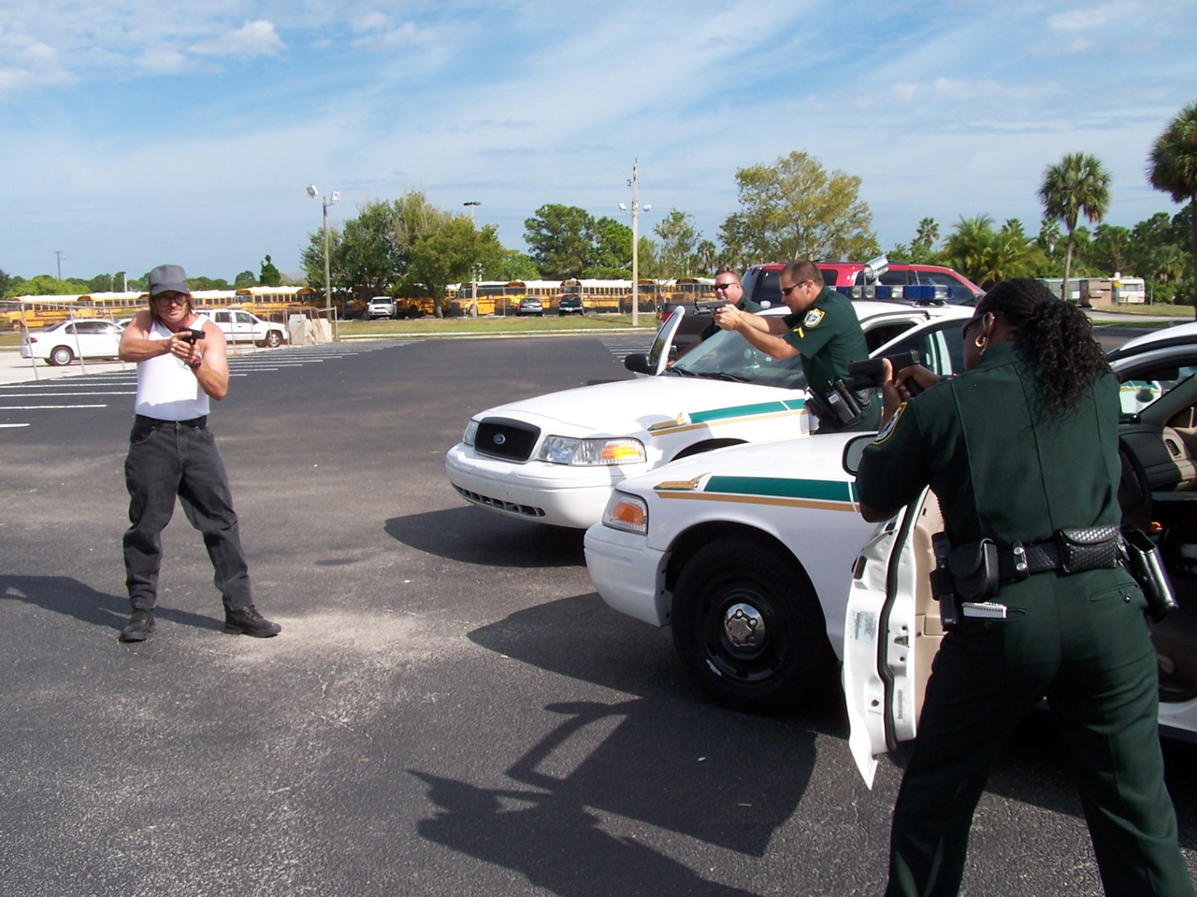
$475,000 for Fallen Law Enforcement Officers & Their Families

Slide 6
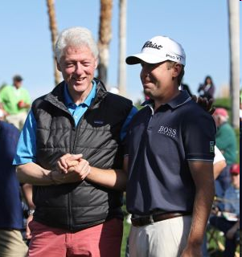
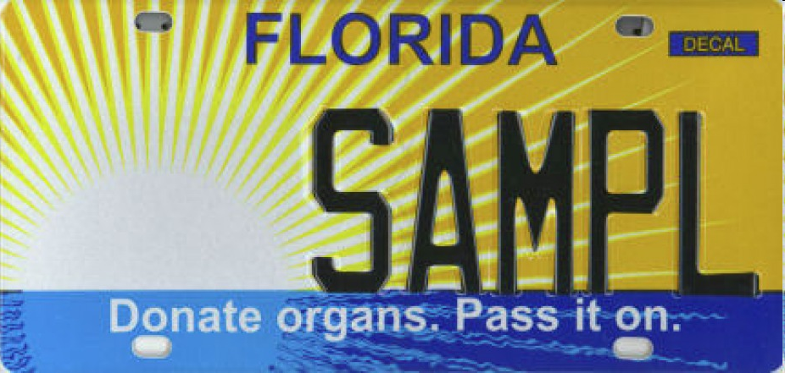

$50,000 for Organ Transplants
PGA Tour Player, Erik Compton
with his 3rd heart and President Clinton

Slide 7
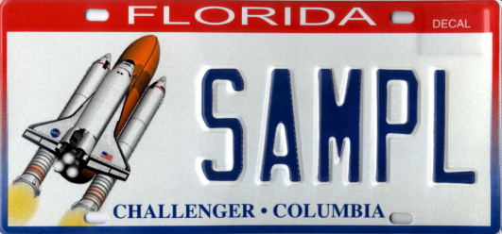
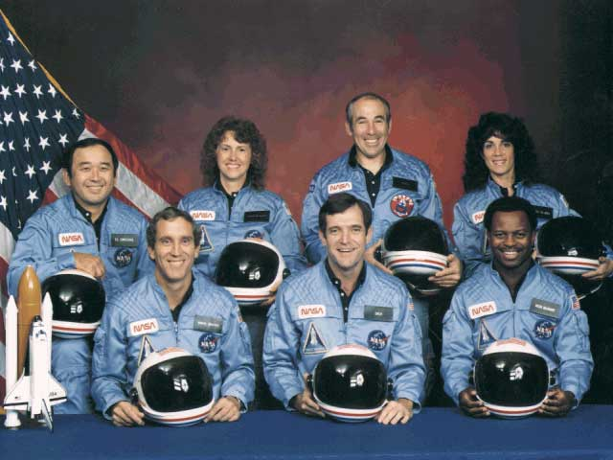
$650,000 For Challenger/Columbia

Slide 8


$650,000 for Agriculture

Slide 9
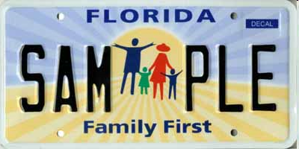
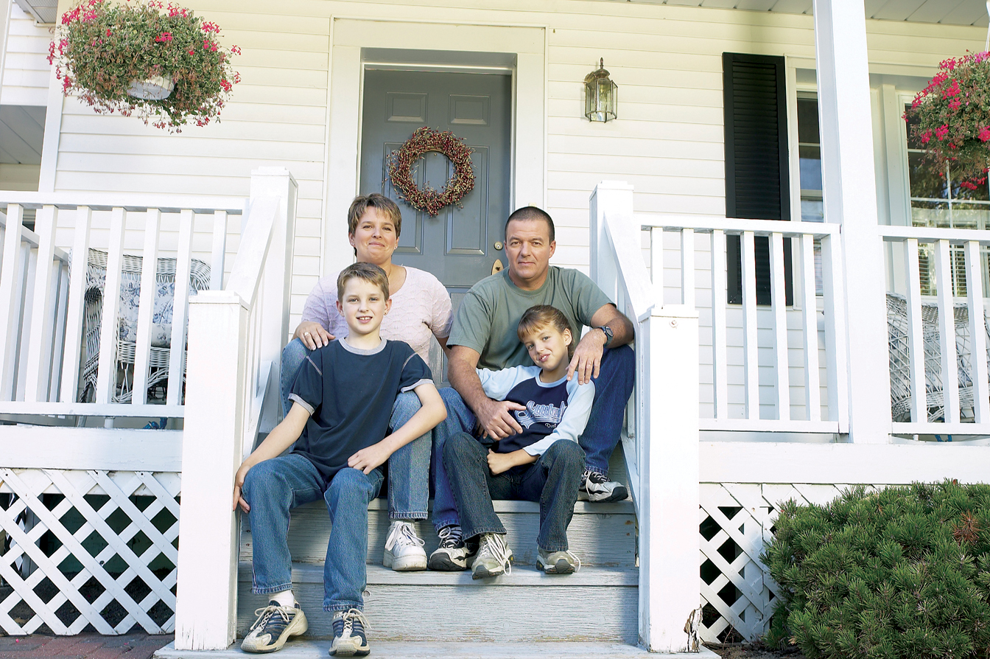
$975,000 to Strengthen Families

Slide 10
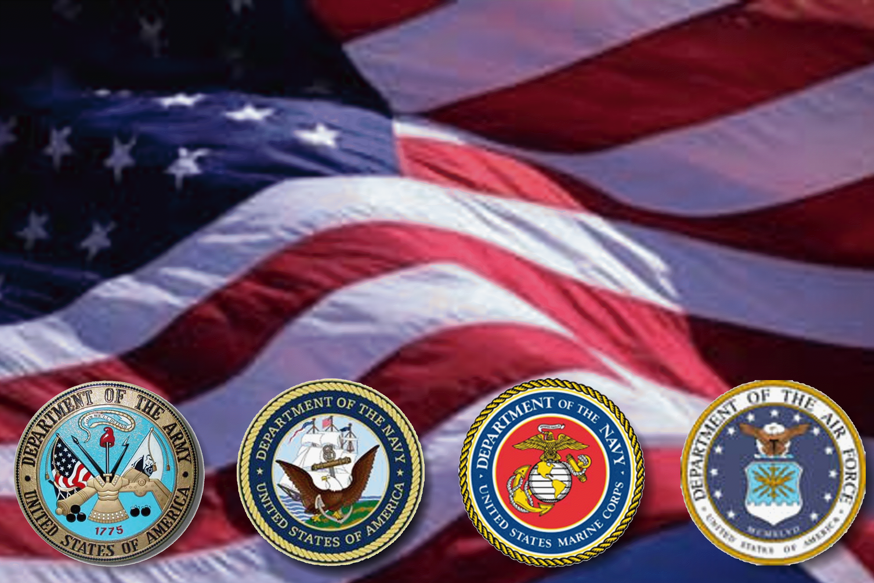
$575,000 for Veterans

Slide 11
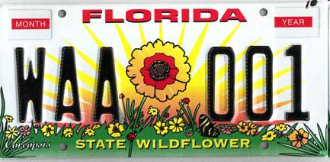
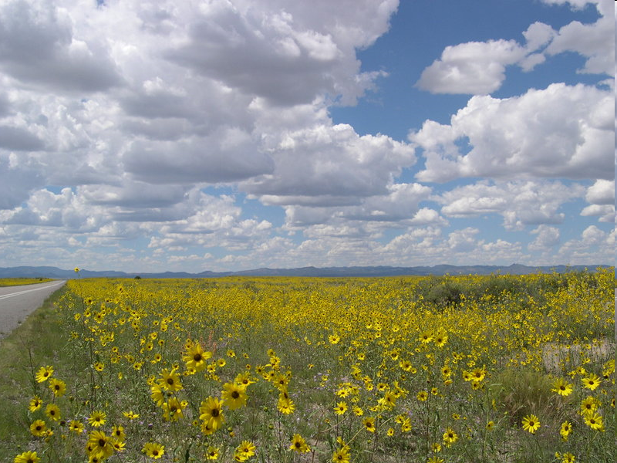
$450,00 for Wildflowers and Beautiful Roads

Slide 12
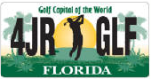
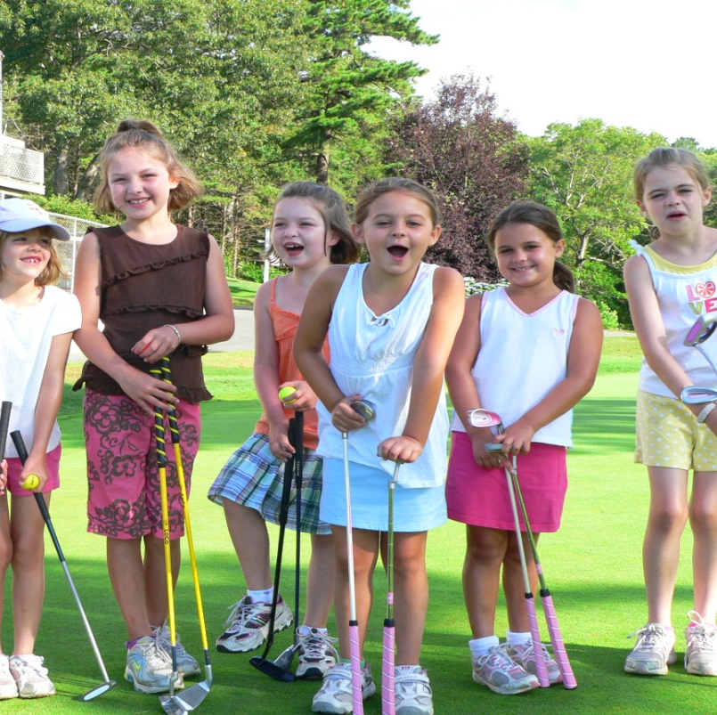
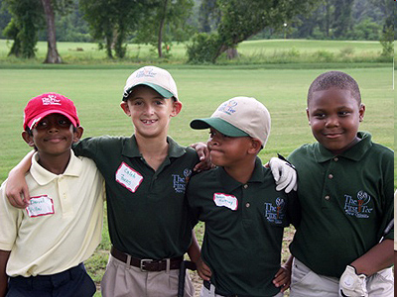
$650,000 for Jr. Golf Summer Camps and After School Programs

Slide 13

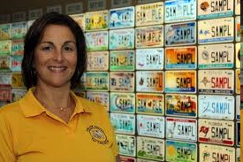
Florida’s Tax Collectors Made It Happen…

Slide 14
Over $20 Million Raised by FSLPA Members
$30 MILLION TOTAL
As Tax Collectors, did you receive the recognition you, and your staff deserve?

Slide 15
OK, I’ll Go Ahead and Say It…
Plates are a pain in the neck
We get all the work, none of the glory
There’s too many of them
My staff expected to be “salesmen”
I’m asked to “pick and choose” promotions among competing plates
Dealing with Specialties slows down my operation

Slide 16
Here’s What We’re Going To Do:
Include Tax Collectors In Handing Out $
  Press Component
      Photo/press release to local papers
      Release & mention in FSLPA/Beneficiaries pubs
      Beneficiary organization awards
      FSLPA Awards
      E-mail Tree to supporters (locally)

Slide 17
Here’s What We’re Going To Do:
Political Component:
  Tax Collectors invite key political leaders to check presentations
  “Plug In” supportive legislators to our press, internal and external publications
  Include these leaders in our local/district e-mail tree
  Joint FSLPA/FTC awards to friendly legislators or local officials

Slide 18
What WE can do TOGETHER
We have a lot in common:
  FSLPA will keep you informed
  We want to keep our members in the loop
  Develop joint education programs for legislators/public
  Identify allies and organize/mobilize
  Legislative Outreach w/ our advocacy organization, the FTC, allied organizations
  Meet again before the next legislative session

Slide 19

Florida Specialty License Plate Association, Inc.
Legislative Update Outlook for 2012

Slide 20

Why The Florida Specialty Plate Association was Created
Created to Protect and Promote Specialty Plates
To Have a Collective Voice in Policy Decisions
To Educate Elected Officials and their Constituents about the Benefits and Positive Impact Specialty Plates have on our State
Provide an economy of scale for Members
20

Slide 21
Why Specialty Plates Organized Grassroots and Remain Vigilant
Threat of Corporate Plates
Threat of Litigation to Disband Program
Threat of more fee increases/drop in sales
Rifts between some plates and agency and legislative personnel
Proactive efforts to work with Agency
Redesign of Plates
Inquiries to work with check-offs
Opportunities for more options in creating revenue

Slide 22
Areas of Legislative Concern for FSLPA
Why the Specialty Plate Moratorium Must Continue
No New Plates Approved, Moratorium Continues
Amendment forbids use of plate revenue for ALL lobbying
Legislature Bans Lobbying with Specialty Plate Fees
Enhanced Drivers Licenses
Check Off Concerns for Members

Slide 23

HOW CAN TAX COLLECTORS BENEFIT?
Takes Burden off Legislature to Fund these issues
Help You Educate your Local Officials
Funding Sources- Invaluable Asset to Elected Officials
Build Base of Support
Enhance Local Delivery of Constituent Services
Provide Resources to your County Residents and Voters
Generate Revenue to Create Jobs and Provide Services
23

Slide 24
Thank you for your attention!
24

